Slide 1


Medicaid Administrative Claiming (MAC) for NWD/ADRC
Presentation for State Level Partner Agencies
About this Tool
This PowerPoint presentation specifically targets engagement of state level partners, such as the Medicaid agency, State Unit on Aging, fiscal and policy staff, or other partners in the NWD System. The presentation template provides a basic outline of information the NWD lead agency could cover. States should adapt these presentations to reflect their own circumstances and desired content. Red text needs to change to reflect state-specific information.
Refer to the Medicaid Claiming Workbook for further guidance.

Slide 2
Objectives
Provide an overview of Administrative Claiming for the NWD System and how it benefits the Medicaid Agency
Review the draft approach for developing the infrastructure necessary for claiming
Discuss the Medicaid agency’s role in the process
Address questions and concerns

Slide 3
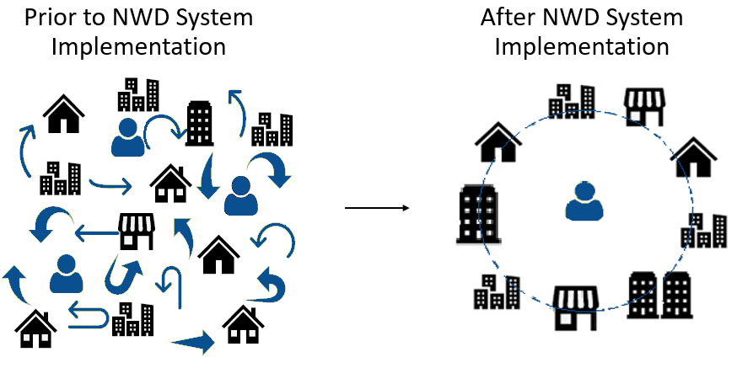
What is a NWD System?

Slide 4
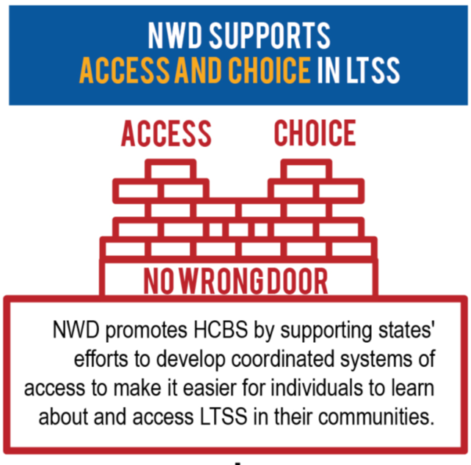
NWD System Vision is NOT Designed to Create New Infrastructure

Slide 5
Our State has HCBS Infrastructure Supporting Access
State Leadership
Agencies, Boards, Councils, Governance, Structure, UCEDDs, AT
CBOs
AAAs, ADRCs*, CILs, Network Lead Entities
Policy
Executive Orders, Workforce Credentialing, Standards
Access Workforce
I&R, Person Centered Planners, and SHIP, Options and Peer Counselors
Technology
Consumer Portal, 1-800 numbers, E&E Platform, 211
Funding/Sustainability
Federal, State, Local, Medicaid Administrative Claiming
Services
I&R, Options Counseling, Nutrition, Transportation, Housing, AT, Energy Assistance
*ADRCs, authorized under Title II of the OAA, are local organizations that have met a threshold/criteria designated by the state

Slide 6
NWD System Key Functions
Four functions shape a single statewide system that includes all populations and all payers as per the NWD Key Elements
State Governance and Administration
Public Outreach and Coordination with Key Referral Sources
Person-Centered Counseling
Streamlined Eligibility to Public Programs
All payers include state programs that pay for LTSS (e.g., Medicaid), individuals who pay for LTSS with their own personal resources, private payers, and other federal payers (e.g., Medicare or VHA)

Slide 7
Medicaid Administrative Claiming (MAC) Overview
Administrative Claiming provides federal financial participation (FFP), generally 50%, to cover activities that contribute to the efficient and effective administration of the Medicaid program
Many local agency functions are potentially eligible for matching Medicaid administrative funds
Administrative claiming can provide an ongoing, sustainable source of funding for NWD activities

Slide 8
NWD Systems Functions Eligible for Claiming
Outreach and consumer education
Intake, application assistance
Planning for future needs – Person Centered Counseling
Triage and screening to prevent Medicaid spend-down, including diversion away from long-term institutionalization by providing resources and support in the community
Continuous quality improvement
Program planning and training

Slide 9
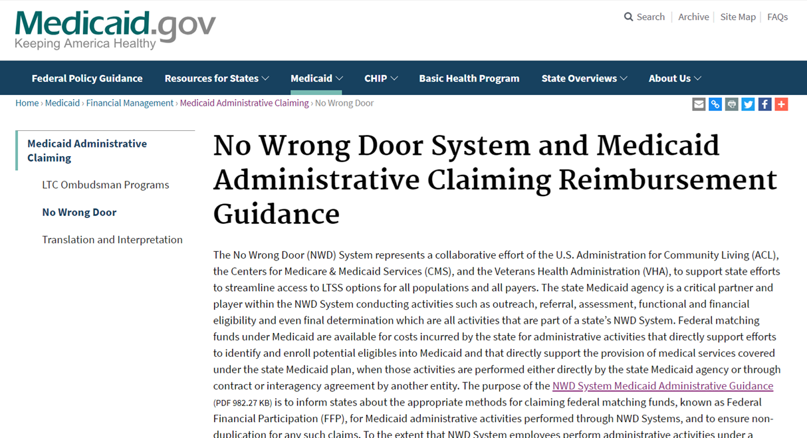
CMS Guidance
https://www.medicaid.gov/medicaid/financial-management/medicaid-administrative-claiming/no-wrong-door-system-and-medicaid-administrative-claiming-reimbursement-guidance/index.html

Slide 10
How much do States Claim?
Annual Reimbursements range from $500,000 to $4,000,000
Reimbursements are used to expand the capacity of the NWD System:
Training/Staff Development
Infrastructure
Dispersed across agency staff

Slide 11
What’s in it for Our NWD System Partners?
Our NWD System already integrates and coordinates access to Medicaid services
Streamlined access to Medicaid potentially reduces Medicaid costs by using functions at the ADRC/NWD to ….
Identify individuals with long term service needs and goals and divert them from more expensive supports to person-centered options that integrate health and social care
Potentially delaying or preventing Medicaid eligibility or spend-down
ADRC/NWD may reduce unnecessary assessments by screening and triaging
Supports person-centered planning
Supports sustainability of NWD System infrastructure

Slide 12
Advantages of NWD System Medicaid Administrative Claiming
Pre-screening results in more appropriate Medicaid applications
Application assistance results in more complete Medicaid applications
CMS NWD claiming guide and ACL technical assistance prevents inappropriate claiming
CMS NWD claiming guidance and precedent in 9 out of 10 CMS regions provides clear road map to Cost Allocation Plan review and approval
NWD System provides assurance of state monitoring of appropriate claiming at the local level through training and oversight

Slide 13
Key Components of Administrative Claiming Infrastructure
Phase II: Develop Agreements and Approvals
Establish Contractual Agreements
Secure CMS/DCA Review and Approval
Phase I: Assess Readiness and Document Medicaid Time
Engage NWD System Lead Agency with a State Medicaid Agency Lead
Identify Permissible Sources of Non-Federal Funds for Match
Identify Costs of Allowable and Allocable Activities
Identify NWD System Activities Potentially Eligible for FFP

Slide 14
Proposed Approach for Claiming Infrastructure
Random Moment Time Study or 100 percent time tracking
Standardized spreadsheet for establishing cost pool
Agency will oversee the development of the infrastructure and ongoing operations

Slide 15
Approach for Developing the Claiming Infrastructure
Show project plan
[Agency Name] will develop and pilot draft codes
  Estimated timeframe is six months
[Agency Name] will develop and work with the local agencies to populate cost pool spreadsheets
[Agency Name] will develop a quality management approach for both the time study and cost pool

Slide 16
Partner Agency’s Roles
Identify the designated contact to assist with Medicaid claiming process
Identify other existing agencies that are claiming
  Might provide good models or be willing to share infrastructure (e.g., can amend a contract or have joint procurement for potential time study vendors/contractors)
Review of the draft codes and approach for the time study
Review of approach for establishing the cost pool
Review the quality management approach and determine the role of the Medicaid agency
Assist in developing the MoU
Submit the package to CMS

Slide 17
Key Elements for Successful Implementation
Build on existing structure within Medicaid agency (identify where MAC happens now and replicate)
Maximize MAC potential by gaining buy-in from all levels including fiscal staff
MAC can be a long-term sustainability strategy for the NWD System (not a grant) if these components are included
Build a strong NWD governing structure to ensure MAC is maximized and used to strengthen access to LTSS in the state
Use federal TA available for guidance and connection with peer states

Slide 18
Thank you!
For more information:
www.nwd.acl.gov

Slide 19
Questions and Concerns?

